Slide 1
Intro to Computer Science and Software Engineering
The Programming Layer
Chapter 8 Abstract Data Types and Subprograms

Slide 2
Abstract Data Type
Useful abstract composite structures
Stacks
Queues
Lists
Trees
Graphs
Each has
its own defining property
the operations that guarantee the property
Insert items
Remove items

Slide 3
Lists and trees
Items can be inserted,deleted
Items can be retrieved
Lists:Retrieval and traversal
Binary tree traversals
Depth-first traversals:
Preorder traversal (NLR)
Inorder traversals (LNR)
Postorder traversals (LRN)
Breadth-first traversals
1
1
1
2
3
2
3
2
3
NLR
LNR
LRN

Slide 4
Lists
General
Restricted
Unordered
Ordered
Random
FIFO
Queue
LIFO
Stack

Slide 5
Stack and Queue
Stack
Displays LIFO behavior
The item removed and returned is the last item (has been in the stack the shortest time) inserted into the stack
Queue
Displays FIFO behavior
The item removed and returned is the first item (has been in the stack the longest time) put into the stack

Slide 6
Graphs
Mathematical algorithms can be applied
Collections of vertices, and a collections of line segments--lines.
Directed graph
Undirected graph
Two vertices in a graph are said to be adjacent vertices if an line directly connects them.

Slide 7
Graphs: operations
Add/delete/find vertex
Add/delete edge
Traversal graph: process each vertex only once!
Depth-first
Breadth-first

Slide 8
Graphs: implementations
548
523
B
D
320
A
200
360
245
F
345
C
E
555
467
A
B
C
D
E
F
A
0 | 523 | 345 | 0 | 0 | 0
523 | 0 | 200 | 548 | 0 | 0
345 | 200 | 0 | 360 | 467 | 0
0 | 548 | 360 | 0 | 245 | 320
0 | 0 | 467 | 245 | 0 | 555
0 | 0 | 0 | 320 | 555 | 0
A
B
B
C
C
D
D
E
E
F
F
vertex array
Adjacency matrix

Slide 9
Subalgorithm
An algorithm can be divided into small units called subalgorithm;
Each subalgorithm is in turn divided into smaller subalgorithms.
This process continues until the subalgorithm become intrinsic (understood immediately)

Slide 10
Subalgorithm
FindLargest
Input: a list of positive integers
1. Set Largest to 0
2. while (more integers)
2.1 FindLarger
End while
3. return Largest
End
FindLarger
Input: Largest and integer
1. if (integer is greater than Largest)
then
1.1 Set Largest to the value of integer
end if
End

Slide 11
Subprogram
Allow sub-algorithms to be implemented independently
Value returning
E.g. a=max(b,c);
Non-value returning(void)
E.g sorted(ls1);

Slide 12
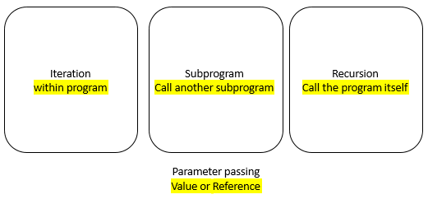
Values vs. Reference
SWAP(item1, item2)
--------------------------
Set temp to item1 Set item2 to item1 Set item1 to temp
SWAP( data1, data2)
value
Calling unit
0002:30
0003:40
30 (data1)
40 (data2)
0002 (data1)
0003 (data2)
SWAP( data1, data2)
reference

Slide 13
Key points
Abstract Data Type (concepts of Stack, Queue, List, Tree and Graph)
Linear Data Types （Stack：FILO, Queue: FIFO, List）
Tree (Binary Searching Trees)

